Slide 1
Chapter 1

Slide 2
Objectives

Slide 3
Objectives (cont.)

Slide 4
Java timeline

Slide 5
Java editions

Slide 6
Operating systems that support Java

Slide 7
Java compared to C++

Slide 8
Java compared to C#

Slide 9
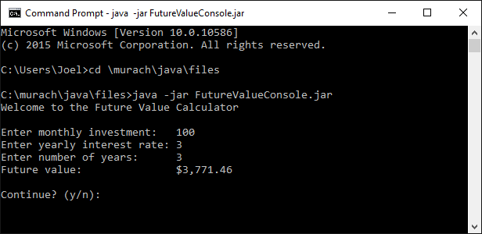
A console application

Slide 10
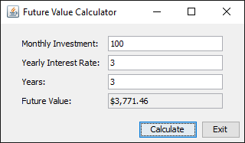
A GUI application

Slide 11
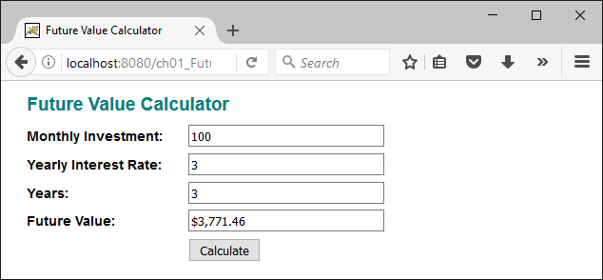
A web application

Slide 12
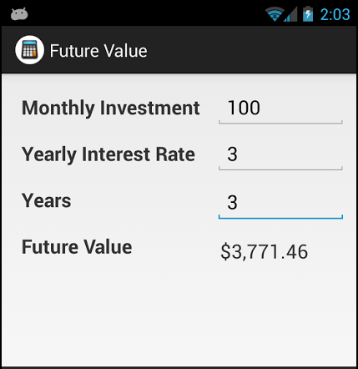
A mobile app

Slide 13
The code for a console application

Slide 14
The code for a console application (cont.)

Slide 15
The code for a console application (cont.)

Slide 16
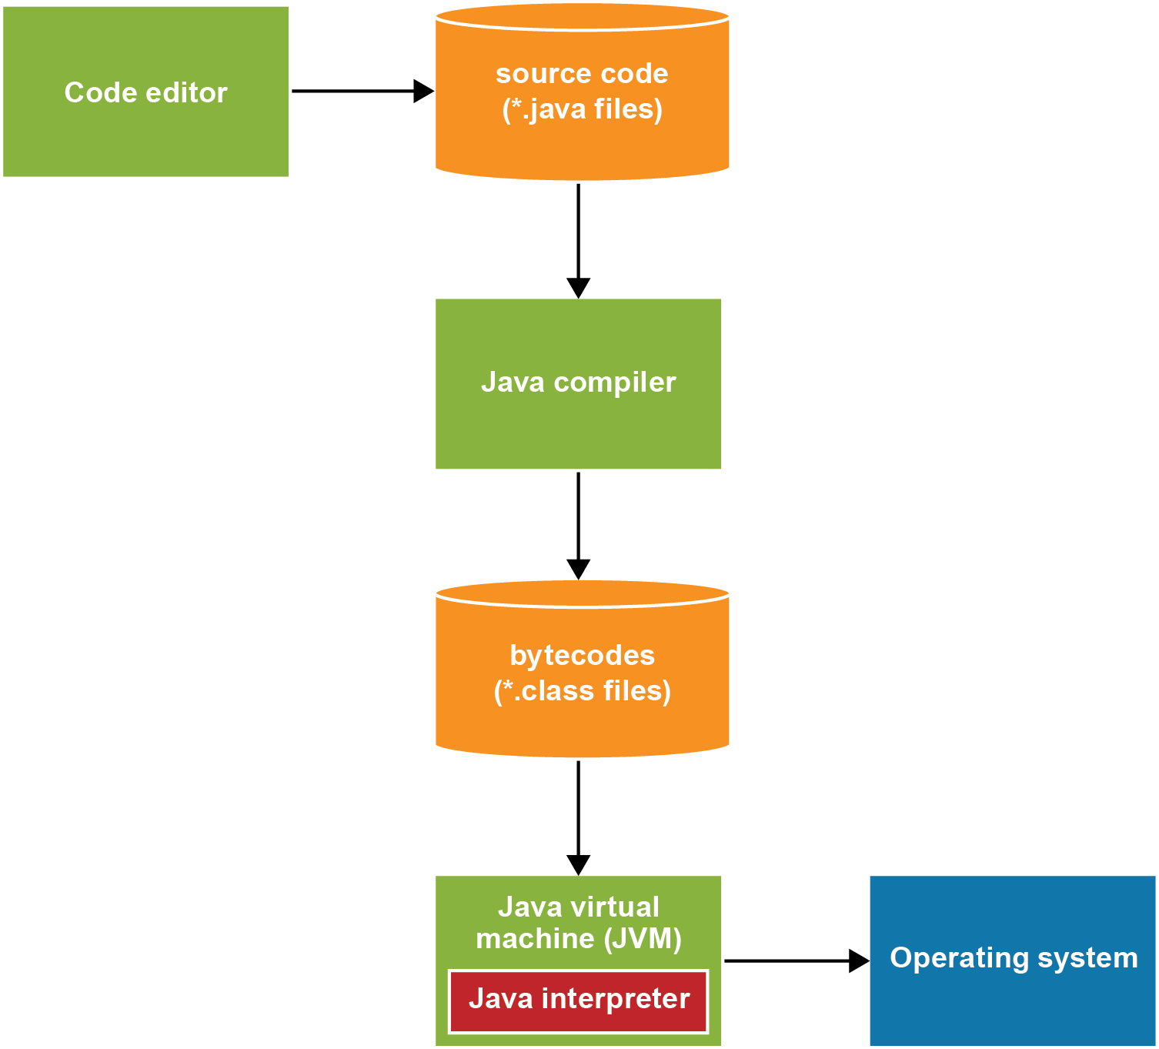
How Java compiles and interprets code

Slide 17
Popular Java IDEs

Slide 18
Features provided by most IDEs

Slide 19
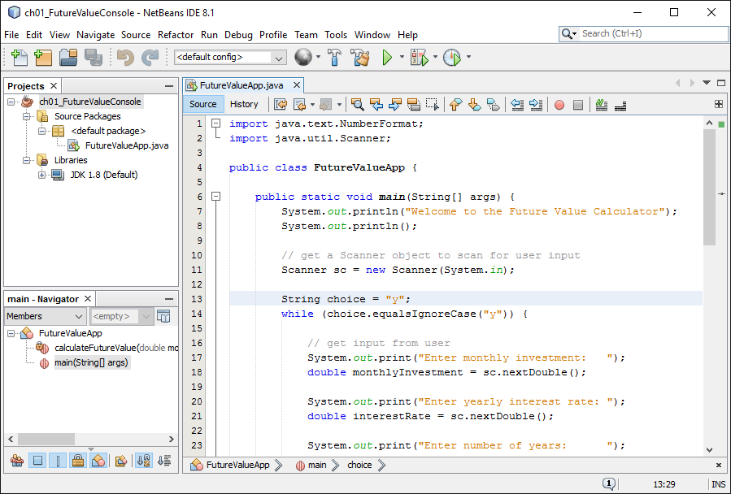
NetBeans with a Java project

Slide 20
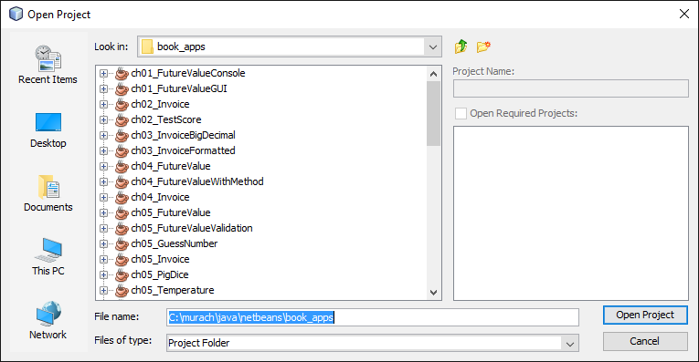
The dialog box for opening a project

Slide 21
How to open, close, and delete a project

Slide 22
How to compile and run a project

Slide 23
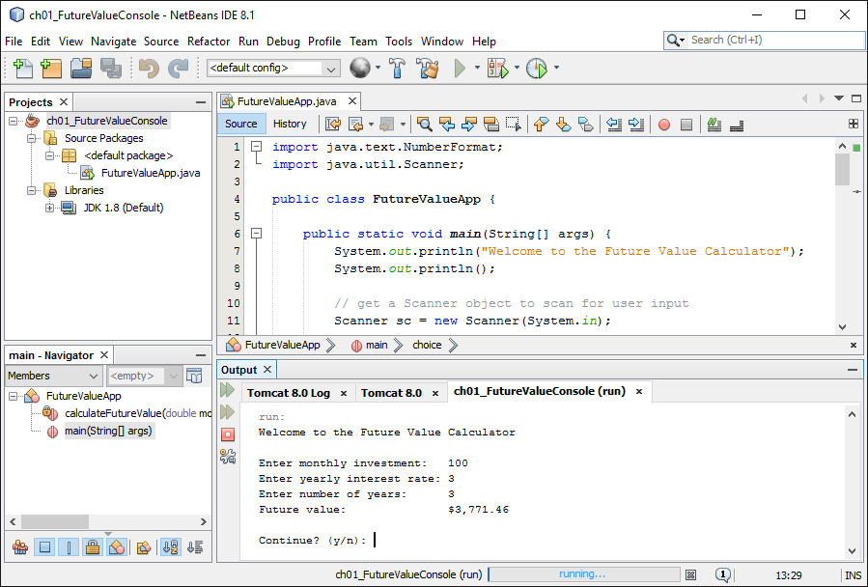
The Output window for input and output

Slide 24
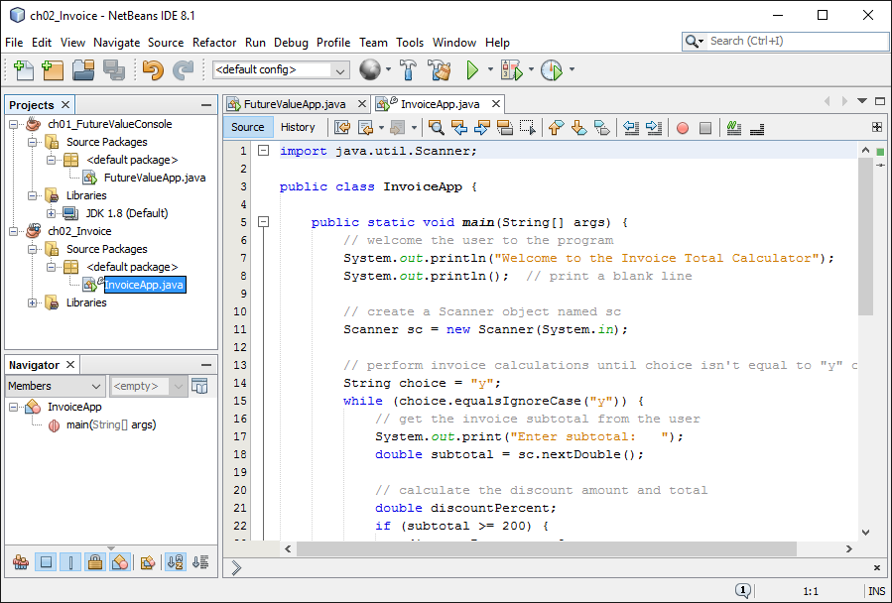
NetBeans with two open projects

Slide 25
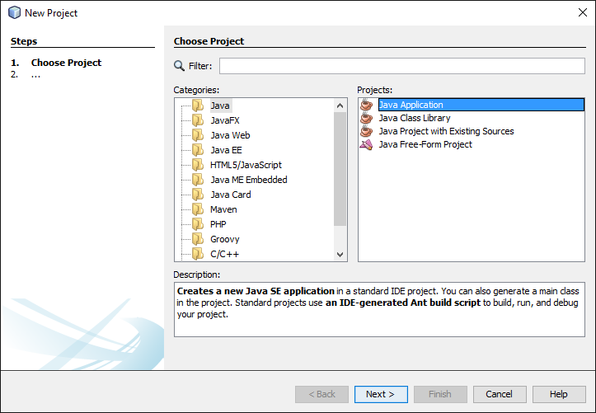
The first dialog box for creating a new project

Slide 26
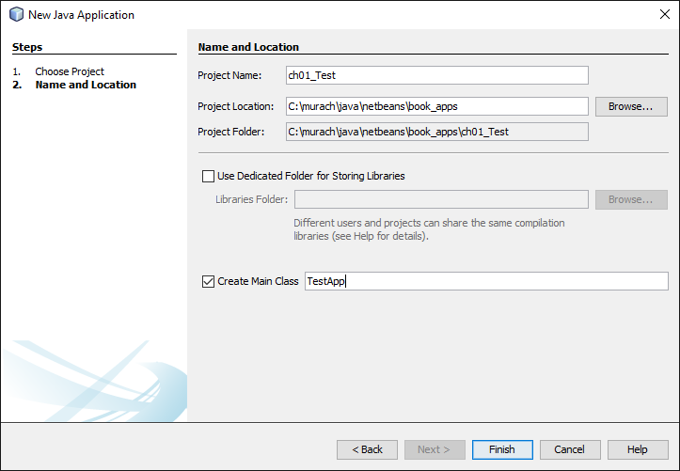
The second dialog box for creating a new project

Slide 27
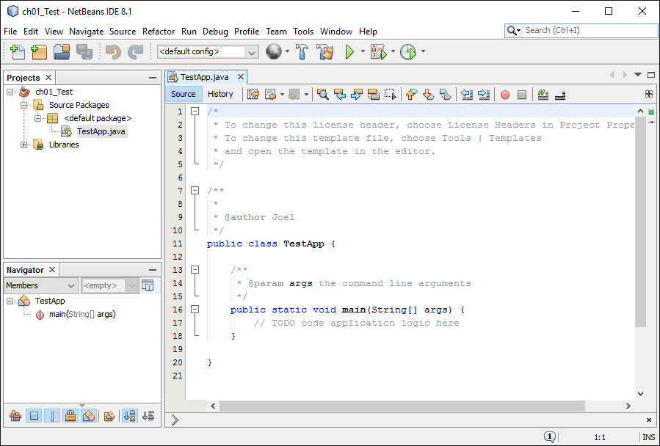
The starting source code for a project

Slide 28
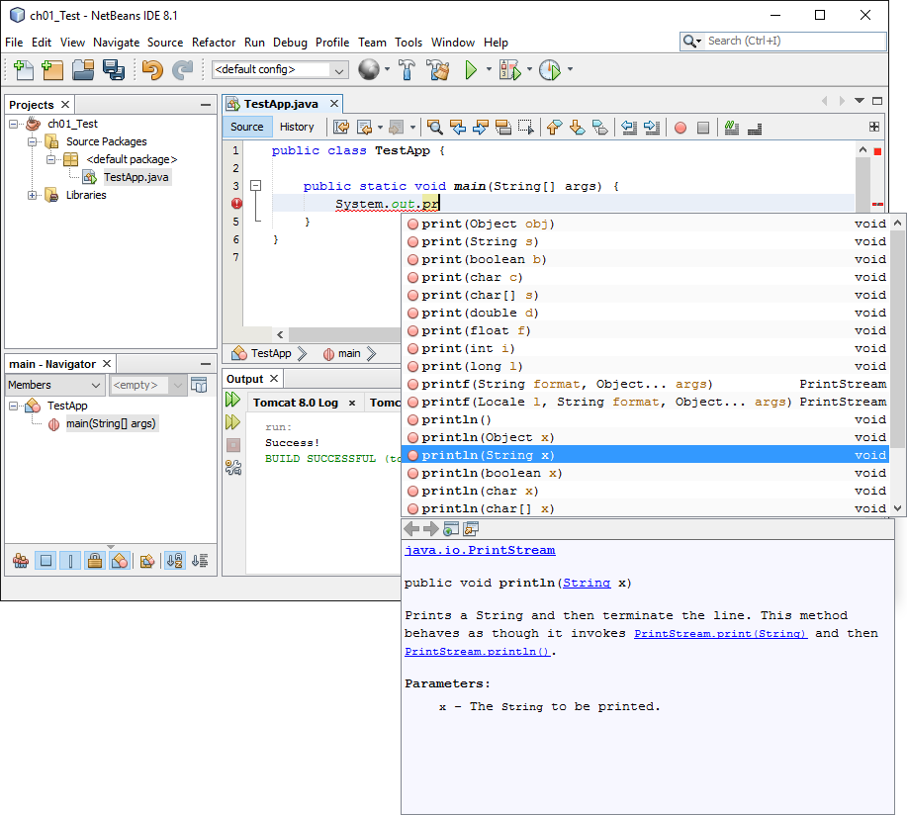
The code editor with a code completion list

Slide 29
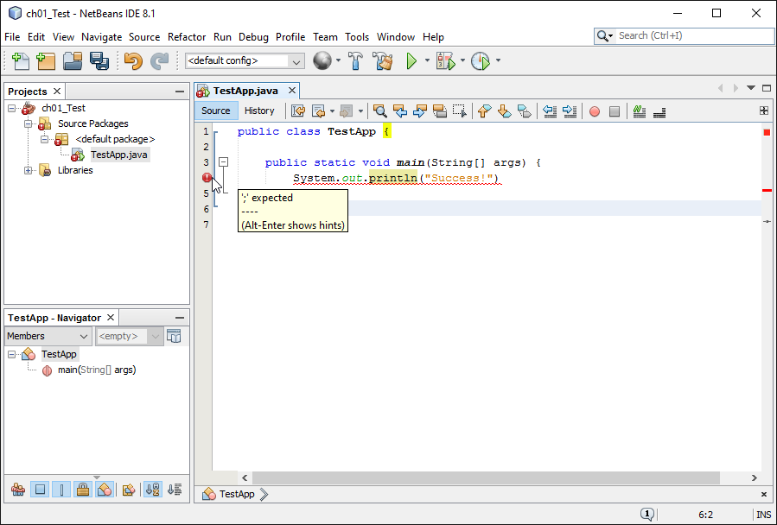
The code editor with an error displayed

